Slide 1
Machine Learning in the Real World Vineet Chaoji Gourav Roy Rajeev Rastogi Core Machine Learning Amazon

Slide 2
Outline
Machine Learning Fundamentals
Supervised Learning
Hands-on ML Modeling Session
ML Problem Formulation to Model Deployment

Slide 3
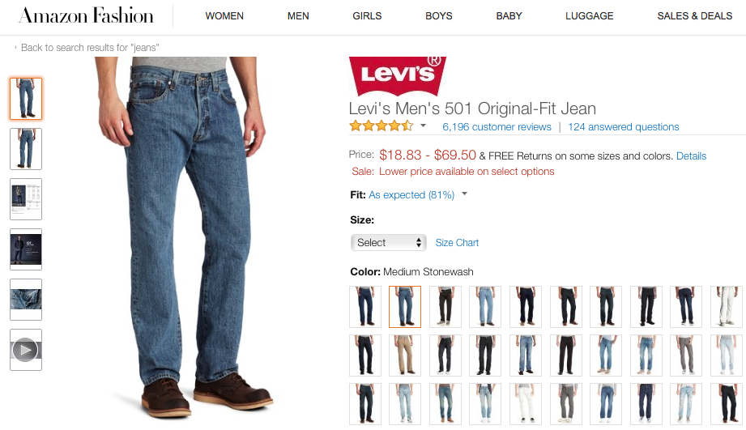
What is Machine Learning?
“Machine Learning systems discover hidden patterns in data, and leverage the patterns to make predictions about future data.”
Example Pattern:
If a product title contains the words “Jeans” or “Jacket”
product belongs to Apparel category

Slide 4
Some Examples
SPAM detection
T: distinguish between SPAM and legitimate email
P: % of emails correctly classified
E: hand-labeled emails
Detecting catalog duplicates
T: distinguish between duplicate and non-duplicate catalog entries
P: false positive/negative rate based on business criteria
E: hand-labeled duplicates and non-duplicates
Go learner
T: playing Go
P: % of games won in tournament
E: practice games against itself

Slide 5
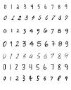
Why Learn?
Learn it when you can’t code it
Complex tasks where deterministic solution don’t suffice
e.g. speech recognition, handwriting recognition
Learn it when you can’t scale it
Repetitive task needing human-like expertise (e.g. recommendations, spam & fraud detection)
Speed, scale of data, number of data points
Learn it when you need to adapt/personalize
e.g., personalized product recommendations, stock predictions

Slide 6

Supervised Learning
Training: Given training examples {(X_{i}, Y_{i})} where X_{i} is the feature vector and Y_{i} the target variable, learn a function F to best fit the training data (i.e., Y_{i} ≈ F(X_{i}) for all i)
Prediction: Given a new sample X with unknown Y, predict Y using F(X)
Historical Data
(X₁, Y₁)
(X₂, Y₂₎
….
(X_{n},Y_{n})
Learning
Algorithm
Model
F
X
Y
URL
Feature
Extraction
Title/Body Text
Model F
E-commerce Site ?
Hyperlinks
Features/Attributes
Target/Label

Slide 7
Machine Learning Problem Definition
Key elements of Prediction Problem
Target variable to be predicted
Training examples
Features in each example (Categorical, Numeric, Text)
Example: Income classification problem
Predict if a person makes more than $50K
Age | Education | Years of education | Marital status | Occupation | Sex | Label
39 | Bachelors | 16 | Single | Adm-clerical | Male | <50K (-1)
31 | Masters | 18 | Married | Engineering | Female | >=50K (+1)
Numeric
Categorical

Slide 8
Types of Supervised Learning
Classification: Y is categorical
Examples:
Web page classification as e-Commerce/non e-Commerce (Binary)
Product classification into categories (Multi-class)
Model F: Logistic Regression, Decision Trees, Random Forests, Support Vector Machines, Naïve Bayes, etc.
Regression: Y is numeric (ordinal/real-valued)
Examples:
Base price markup prediction for a product
Forecasting demand for a product
Model F: Linear Regression, Regression Trees, Kernel Regression, etc.

Slide 9
Types of Features
Age | Education | Years of education | Marital status | Occupation | Sex | Label
39 | Bachelors | 16 | Single | Adm-clerical | Male | <50K (-1)
31 | Masters | 18 | Married | Engineering | Female | >=50K (+1)
Numeric
Categorical
Categorical/Nominal – Occupation, Marital Status, Prime Subscriber
Numeric – Age, Orders in the last month, Total spend in the last year
Quantity (Integer or Real): Price, Votes
Interval: Dates, Temperature
Ratio: Quarterly growth
Ordinal – Education level, Star rating for a product

Slide 10
Types of Data
Matrix Data – A design matrix X and label vector y
Text – Customer reviews, product descriptions
Images – Product images, Maps
Set Data – Items purchased together
Sequence Data – Clickstream, Purchase history
Time Series – Audio/Video, Stock prices
Graph/Network – Social Networks, WWW
Notes:
Graph data, time series

Slide 11
Types of Learning
Supervised Learning – Input is data/label pairs S={(x_{i},y_{i})}; i=1,…,m
Classification, Regression
Unsupervised Learning – Input is data S={(x_{i})}; i=1,…,m
Clustering, Density Estimation, Dimensionality Reduction
Semi-supervised Learning – Input is data S_{l}={(x_{i},y_{i})}; i=1,…,L and S_{u}={(x_{j})}; j=L+1,…,m
Used for supervised and unsupervised tasks
Active Learning – Semi-supervised learning with access to a human labeler during training
Reinforcement Learning – Feedback received after a sequence of actions/predictions

Slide 12
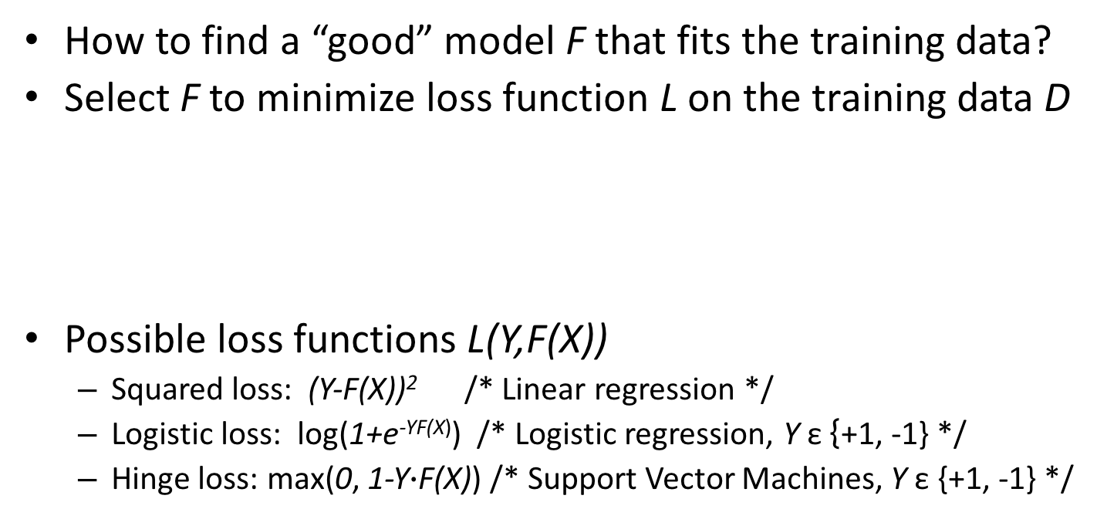
Loss Functions
How to find a “good” model F that fits the training data?
Select F to minimize loss function L on the training data D
Possible loss functions L(Y,F(X))
Squared loss: (Y-F(X))² /* Linear regression */
Logistic loss: log(1+e^{-YF(X)}) /* Logistic regression, Y ε {+1, -1} */
Hinge loss: max(0, 1-Y$∙$F(X)) /* Support Vector Machines, Y ε {+1, -1} */

Slide 13
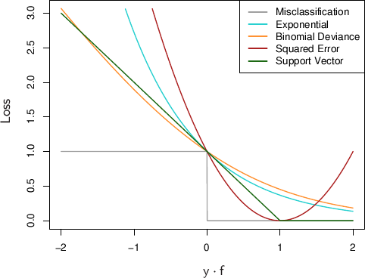
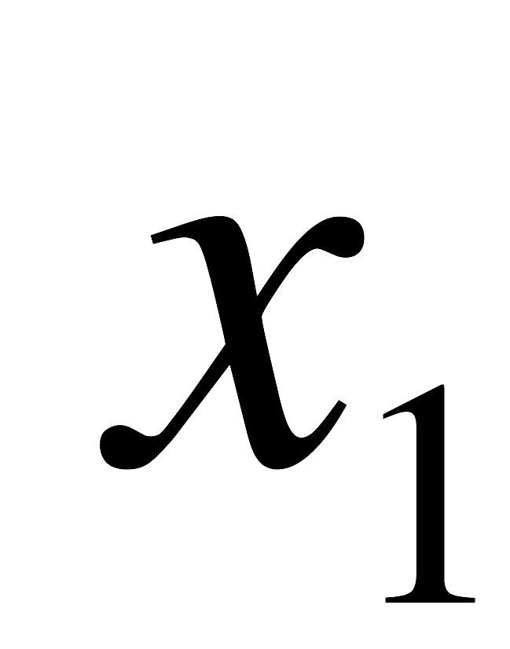
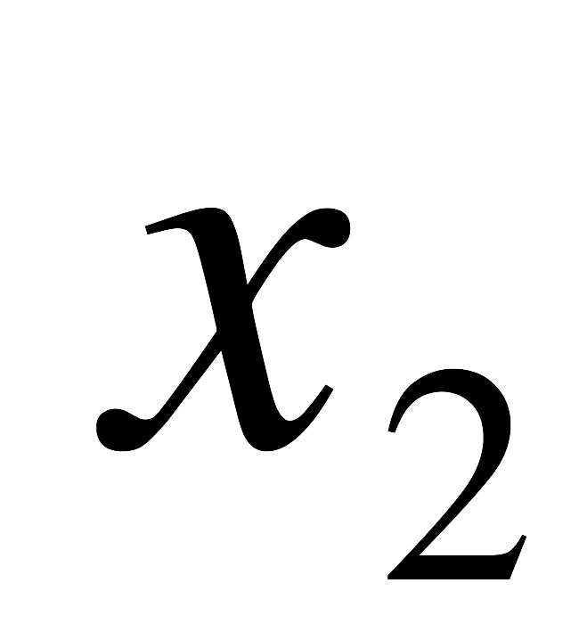
Loss Functions Examples
Infinite number of possible linear functions
Want to minimize loss

Slide 14
Loss Functions Examples (Contd.)
Infinite number of possible linear functions
Want to minimize loss

Slide 15
Loss Functions Examples (Contd.)
Infinite number of possible linear functions
Want to minimize loss

Slide 16
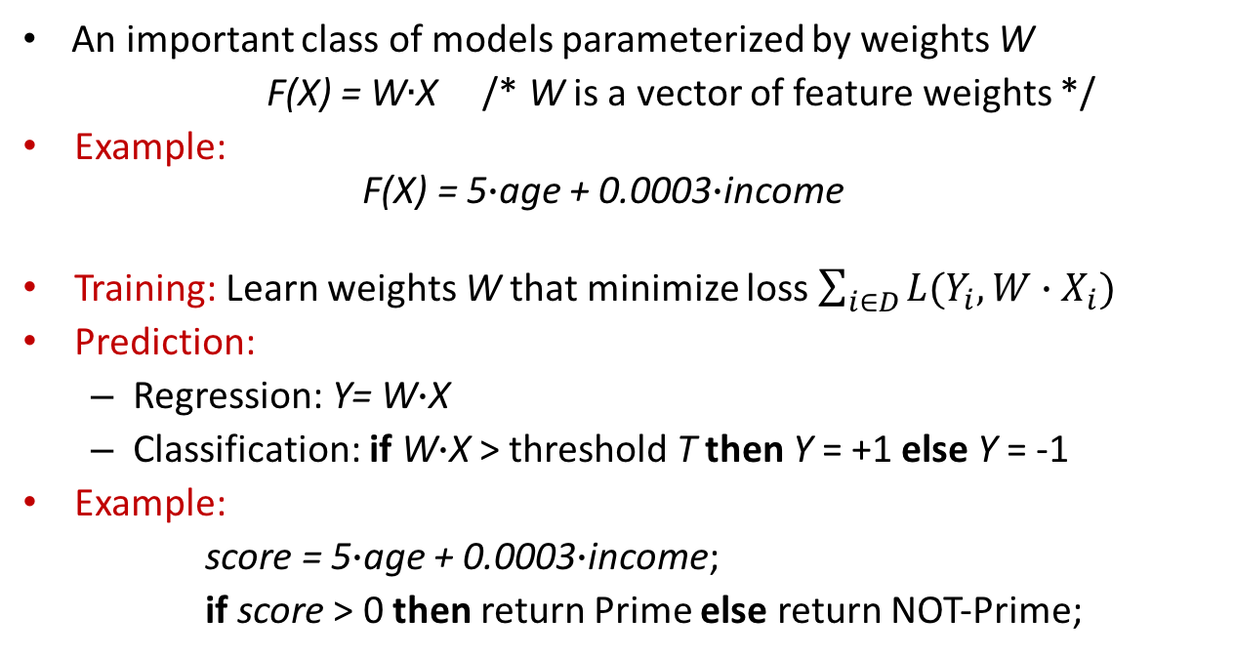
Linear Models
An important class of models parameterized by weights W
F(X) = W$∙$X /* W is a vector of feature weights */
Example: F(X) = 5$∙$age + 0.0003$∙$income
Training: Learn weights W that minimize loss $\sum_{i∈D}{L(Y_{i},W∙X_{i})}$
Prediction:
Regression: Y= W$∙$X
Classification: if W$∙$X > threshold T then Y = +1 else Y = -1
Example:
score = 5$∙$age + 0.0003$∙$income;
if score > 0 then return Prime else return NOT-Prime;

Slide 17
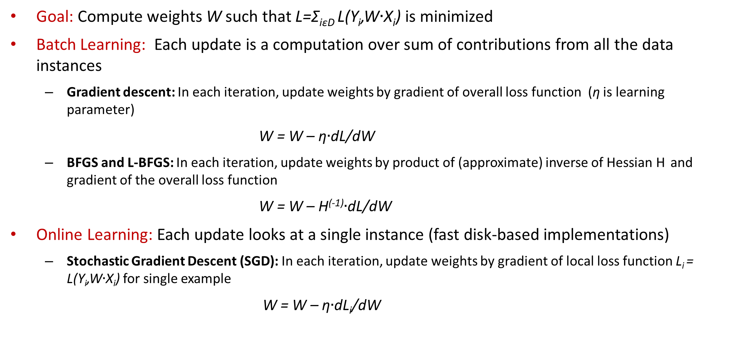
Linear Models: Learning Algorithms
Goal: Compute weights W such that L=Σ_{iεD} L(Y_{i},W$∙$X_{i}) is minimized
Batch Learning: Each update is a computation over sum of contributions from all the data instances
Gradient descent: In each iteration, update weights by gradient of overall loss function (η is learning parameter)
W = W – η$∙$dL/dW
BFGS and L-BFGS: In each iteration, update weights by product of (approximate) inverse of Hessian H and gradient of the overall loss function
W = W – H⁽⁻¹⁾$∙$dL/dW
Online Learning: Each update looks at a single instance (fast disk-based implementations)
Stochastic Gradient Descent (SGD): In each iteration, update weights by gradient of local loss function L_{i} = L(Y_{i},W$∙$X_{i}) for single example
W = W – η$∙$dL_{i}/dW

Slide 18
Supervised Learning Recap
We want to learn a function F that predicts y for a given x
Need a feature space representation (Categorical, Numeric, Text)
Want a function that generalizes to new (testing) data
Example: Income classification problem
Predict if a person makes more than $50K
Age | Education | Years of education | Marital status | Occupation | Sex | Label
39 | Bachelors | 16 | Single | Adm-clerical | Male | <50K (-1)
31 | Masters | 18 | Married | Engineering | Female | >=50K (+1)
Numeric
Categorical

Slide 19
Overfitting
Overfitting problem: Model fits training data well (low training error) but does not generalize well to unseen data (poor test error)
Complex models with large #parameters capture not only good patterns (that generalize) but also noisy ones
Y
High prediction error
X
Notes:
- Deep learning

Slide 20
Underfitting
Underfitting problem: Model lacks the expressive power to capture target distribution (poor training and test error)
Simple linear model cannot capture target distribution
Y
X
Notes:
- One tool here is random forest, but many non-linear techniques (LOWESS regression, decision trees, nearest neighbors)

Slide 21
Linear Models: Regularization
Regularization prevents overfitting in linear models by penalizing large weight values
L₁ regularization: Add a term to loss function L
Aggressively reduces number of non-zero weights
L₂ regularization: Add a term to loss function L
Less aggressive in forcing weight values to zero

Slide 22
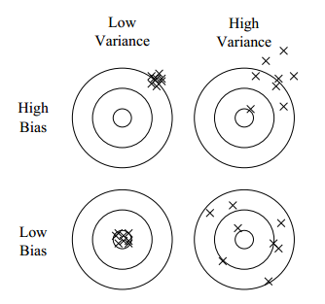
Bias-Variance Tradeoff
Bias: Difference between average model prediction and true target value
Variance: Variation in predictions across different training data samples
(Overfitting)
(Underfitting)

Slide 23
Bias-Variance Tradeoff
Simple models with small #parameters have high bias and low variance
E.g. Linear models with few features
Reduce bias by increasing model complexity (adding more features, decreasing regularization)
Complex models with large #parameters have low bias and high variance
E.g. Linear models with many sparse features, decision trees
Reduce variance by increasing training data and decreasing model complexity (feature selection, aggressive regularization)

Slide 24
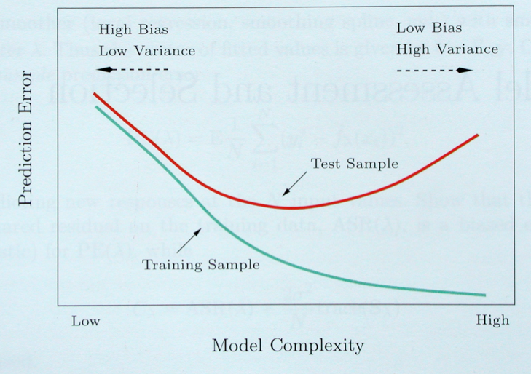
Bias-Variance Trade-off
Overfitting Region

Slide 25
End-to-End Model Building Process
Business Problem
ML Problem Framing
ML Problem + Metrics
Data Collection & Integration
Dataset
Data Preparation & Cleaning
High Quality Dataset
Data Visualization & Analysis
Data Summary reports
Data Augment
Feature Engineering
Feature Augment
Feature Vectors + Target
Model Training + Parameter Tuning
Predictive Model
Model Evaluation
Performance Metrics
Meet Business Goals?
No
Yes
Model Deployment
Predictions

Slide 26
Hands-on Session
Background

Slide 27
Model Building Process
Business Problem
ML Problem Framing
ML Problem + Metrics
Data Collection & Integration
Dataset
Data Preparation & Cleaning
High Quality Dataset
Data Visualization & Analysis
Data Summary reports
Data Augment
Feature Engineering
Feature Augment
Feature Vectors + Target
Model Training + Parameter Tuning
Predictive Model
Model Evaluation
Performance Metrics
Meet Business Goals?
No
Yes
Model Deployment
Predictions

Slide 28
Machine Learning Problem Definition
Key elements of Prediction Problem
Target variable to be predicted
Training examples
Features in each example (Categorical, Numeric, Text)
Example: Income classification problem
Predict if a person makes more than $50K
Age | Education | Years of education | Marital status | Occupation | Sex | Label
39 | Bachelors | 16 | Single | Adm-clerical | Male | <50K (-1)
31 | Masters | 18 | Married | Engineering | Female | >=50K (+1)
Numeric
Categorical

Slide 29
Example Applications
What is the target variable to be predicted, training examples and features for the following ML problems
Forecasting the demand for a product
Classifying products into categories
Detecting fraudulent orders
Predicting the base price of a product
Predicting if a user will click on an ad
Recommending products to customers
Matching products to identify duplicates

Slide 30
Model Building Process
Business Problem
ML Problem Framing
ML Problem + Metrics
Data Collection & Integration
Dataset
Data Preparation & Cleaning
High Quality Dataset
Data Visualization & Analysis
Data Summary reports
Data Augment
Feature Engineering
Feature Augment
Feature Vectors + Target
Model Training + Parameter Tuning
Predictive Model
Model Evaluation
Performance Metrics
Meet Business Goals?
No
Yes
Model Deployment
Predictions

Slide 31
Data Collection & Integration
Multiple data sources
Data Warehouse (DW)
Search query logs
Timber logs
Dynamo DB
Web pages (Wikipedia, competitors)
Data access/integration tools
SQL queries (for DW data)
Hive (for large joins)
Pig (for large joins)
select gl_product_group
, category_code
, subcategory_code
, ASIN
, item_name
from booker.d_mp_asins_essentials
where region_id=1
and marketplace_id=1

Slide 32
Key Data at Amazon
DW contains diverse data
Entity | Attributes
ASIN | Title, Description, Amazon price, GL, Cat, Subcat, Sales, GMS, Glance Views
Customer | Purchase/Browse history, Segmentation details, Contacts made, Product reviews, Prime/Amazon Mom membership
Seller | Buyable offers, Ratings, GMS, Sales
Order | Payment method, Shipping option, GC amount, Gift option, Billing/Shipping address
Clickstream | Customer ID, Source IP address, Associate tag, ASIN availability, Glance Views

Slide 33
Model Building Process
Business Problem
ML Problem Framing
ML Problem + Metrics
Data Collection & Integration
Dataset
Data Preparation & Cleaning
High Quality Dataset
Data Visualization & Analysis
Data Summary reports
Data Augment
Feature Engineering
Feature Augment
Feature Vectors + Target
Model Training + Parameter Tuning
Predictive Model
Model Evaluation
Performance Metrics
Meet Business Goals?
No
Yes
Model Deployment
Predictions

Slide 34
Data Preparation
Transform data to appropriate input format
CSV format, headers specifying column names and data types
Filter XML/HTML from text
Split data into train and test files
Training data used to learn models
Test data used to evaluate model performance
Randomly shuffle data
Speeds convergence of online training algorithms
Feature scaling (for numeric attributes)
Subtract mean and divide by standard deviation -> zero mean, unit variance
Speeds convergence of gradient-based training algorithms

Slide 35
Data Cleaning
Missing feature values, outliers can hurt model performance
Strategies for handling missing values, outliers
Introduce new indicator variable to represent missing value
Replace missing numeric values with mean, categorical values with mode
Regression-based imputation for numeric values
Age | Education | Years of education | Marital status | Occupation | Sex | Label
39 | Bachelors | 16 | Single | Adm-clerical | Male | 0
31 | Masters | 18 | Married | Engineer | Female | 1
44 | Bachelors |  |  | Accounting | Male | 0
 | Bachelors | 14 | Married | Engineer | Female | 0
16
Married
150
38
Outlier
Mean
Missing values
Mode

Slide 36
Model Building Process
Business Problem
ML Problem Framing
ML Problem + Metrics
Data Collection & Integration
Dataset
Data Preparation & Cleaning
High Quality Dataset
Data Visualization & Analysis
Data Summary reports
Data Augment
Feature Engineering
Feature Augment
Feature Vectors + Target
Model Training + Parameter Tuning
Predictive Model
Model Evaluation
Performance Metrics
Meet Business Goals?
No
Yes
Model Deployment
Predictions

Slide 37
Data Visualization & Analysis
Better understanding of data -> Better feature engineering & modeling
Types of visualization & analysis
Feature and target summaries
Feature and target data distribution, histograms
Identify outliers in data, detect skew in feature/class distribution
Feature-Target correlation
Correlation measures like mutual information, Pearson’s correlation coefficient
Class distribution conditioned on feature values, scatter plots
Identify features with predictive power, target leakers

Slide 38
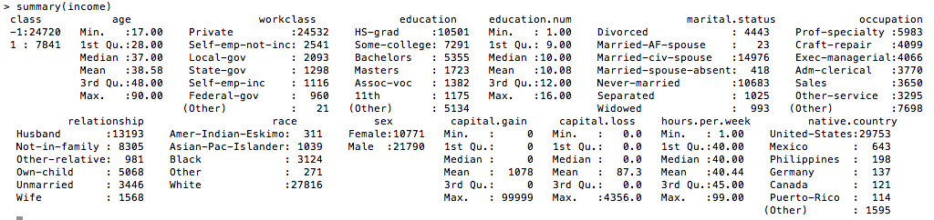
Feature and Target Summaries
Example (Income Classification):
Target
Feature names

Slide 39
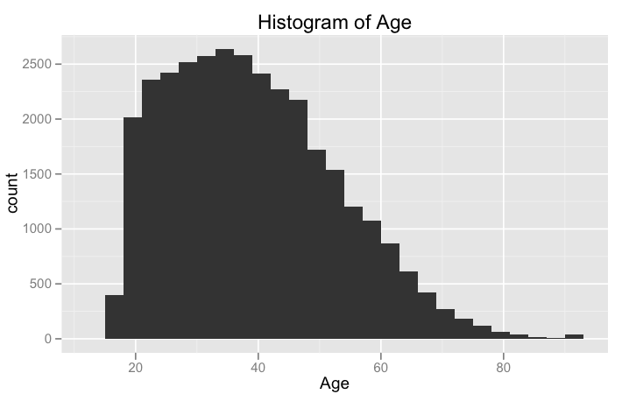
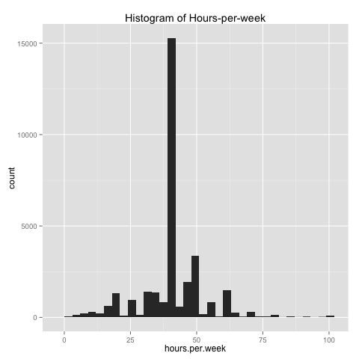
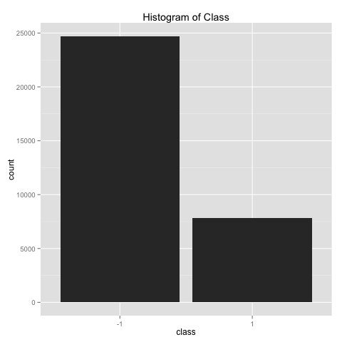
Feature and Target Histograms
Useful to detect skew in data, imbalanced class distribution

Slide 40
Feature-Target Correlation
Identify features (with signal) that are correlated with target
Mutual information: Captures correlation between categorical feature (A) and class label (Y)
p(x,y): Fraction of examples with A=x and Y=y
p(x), p(y): Fraction of examples with A=x, Y=y

Slide 41
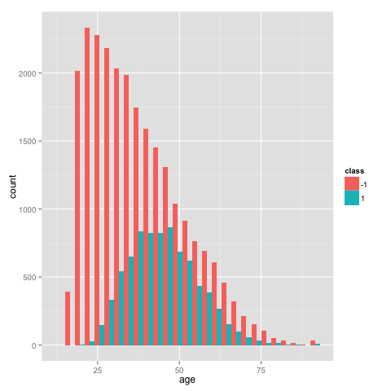
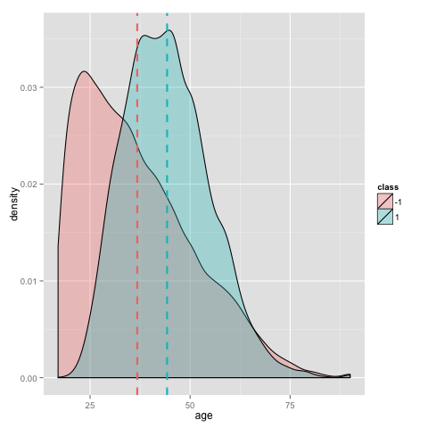
Feature-Target Correlation
Class histograms conditioned on feature value
Identify features with predictive power

Slide 42
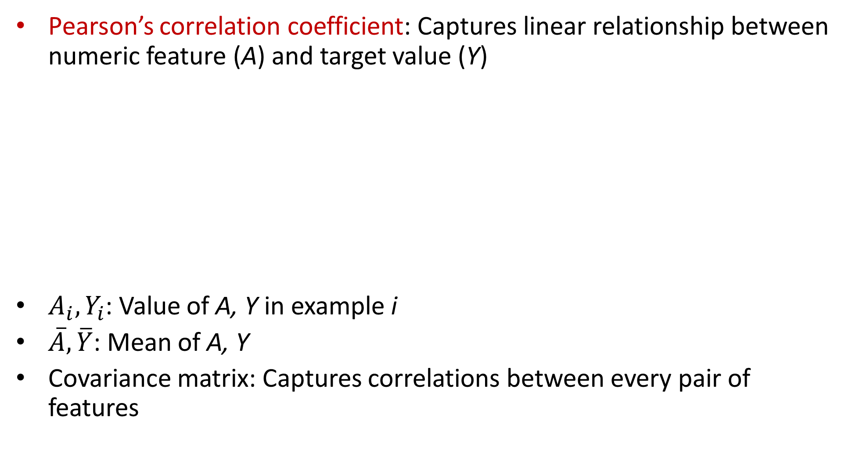
Feature-Target Correlation
Pearson’s correlation coefficient: Captures linear relationship between numeric feature (A) and target value (Y)
$A_{i},Y_{i}$: Value of A, Y in example i
$\overline{A},\overline{Y}$: Mean of A, Y
Covariance matrix: Captures correlations between every pair of features

Slide 43
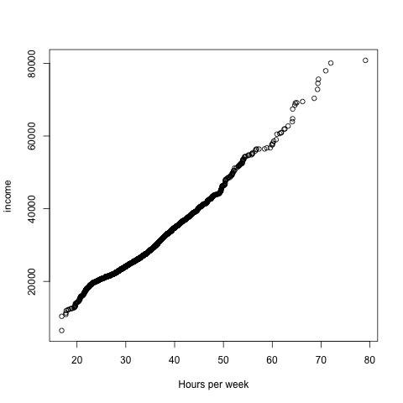
Feature-Target Correlation
Scatterplots: Plot feature values against target values
Hours per week is strongly correlated with income!

Slide 44
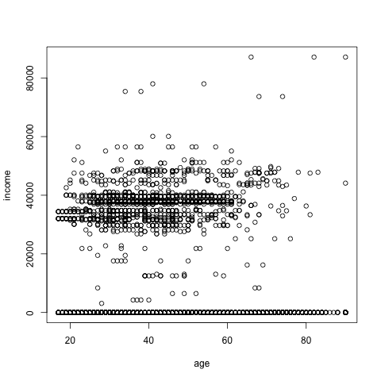
Feature-Target Correlation
Scatterplot of age vs income
Age is weakly correlated with income!

Slide 45
Hands-on Session
Practical

Slide 46
Tools/Frameworks used
Jupyter notebook
Docker for hosting notebook server
Python
Pandas – Easy to use data analysis tools for Python
Numpy – Scientific computation with Python and efficient multi-dimensional container of generic data.
Seaborn - Python visualization library & provides a high-level interface for drawing attractive statistical graphics.
Based on Matplotlib – A python 2D plotting library.
Integration with Pandas and Numpy data-structures.
Spark
Spark ML Pipeline – Easy to use distributed machine learning library.

Slide 47
Notebook UI trivia
To execute a command -> shift + enter
Code auto-completion -> tab
Help with a command -> shift + tab

Slide 48
Data collection & Integration
Data is ubiquitous
S3/Dynamo/Redshift/Data warehouse/Internet(Crawlers to crawl internet)
Fetch the data
Clean the data
Convert to known format like CSV/TSV/ND-Json
Aggregate the data to map to a single schema
Analogous to defining a table
This phase is trivialized for the sake of simplicity
1994 US Census data from UCI ML repository
Widely used and cited across many published ML papers

Slide 49
Dealing with missing values
Option1: Do nothing
Option2: Delete the cases/rows
Option3: Impute the missing values
Imputation is replacing a missing value with a reasonable one
Imputation is found to improve the model performance dramatically when done right.

Slide 50
Impute missing values
Numeric
Mean
Median
Categorical
Mode
Build model with current feature as target
Predicts the missing values based on other feature information

Slide 51
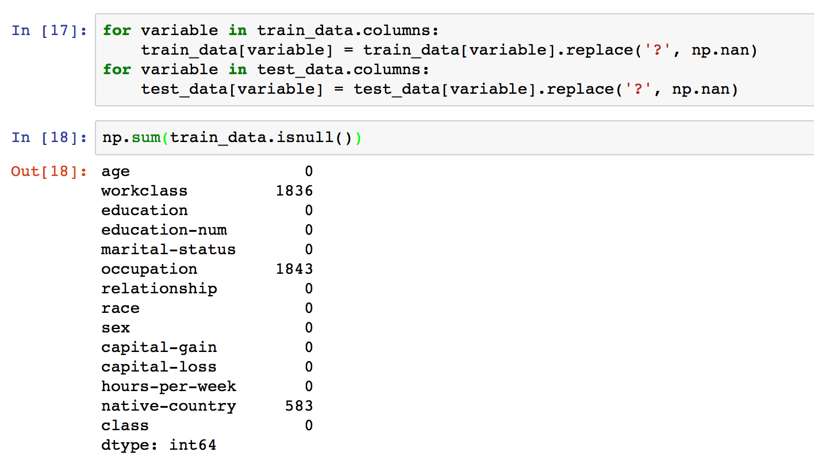
Impute missing values

Slide 52
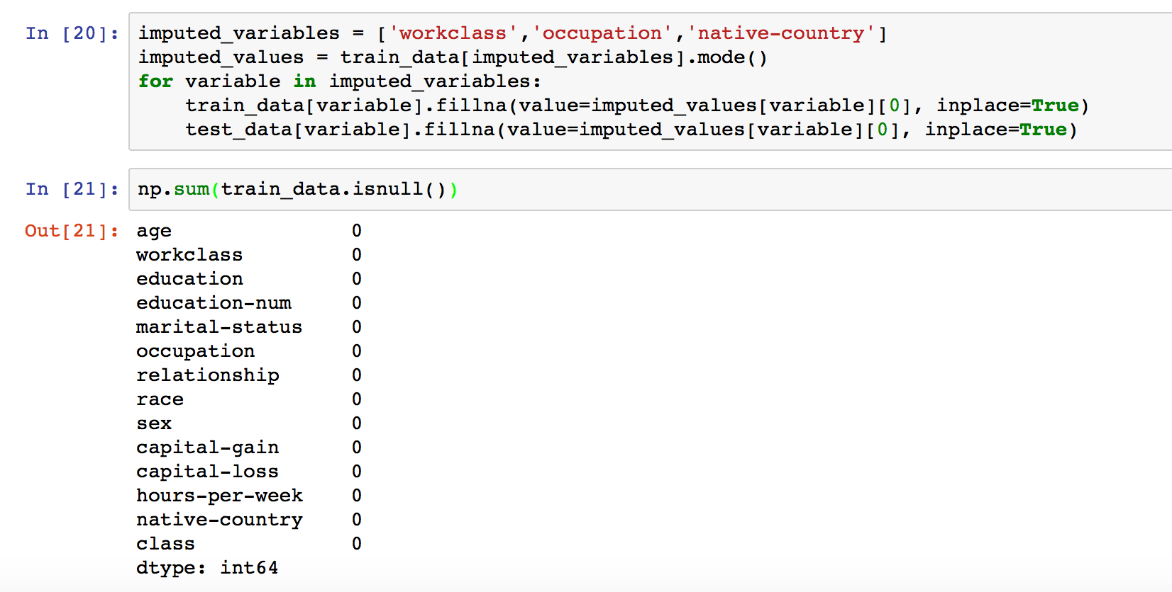
Impute missing values…

Slide 53
Shuffle training data
Shuffling results in better model performance for certain algorithms
Minimizes the risk of cross validation data under representing the model data AND model data not learning from all type of data.

Slide 54
Overview
Understand the data better
Quality / Missing values
Outliers
Summary information
Gain insights into the data
Distribution
Underlying structures
Understand important variables / signals
Correlations
Feature-target
Feature-feature
Target distributions

Slide 55
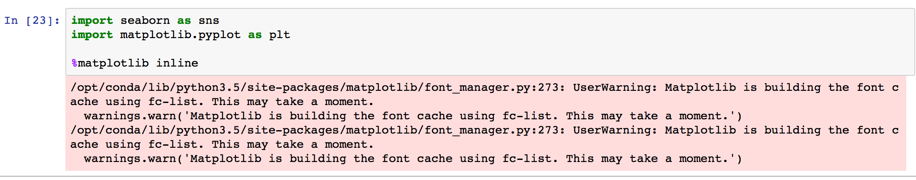
Feature and target summaries
Import seaborn library for plotting graphs
Ignore warning messages.

Slide 56
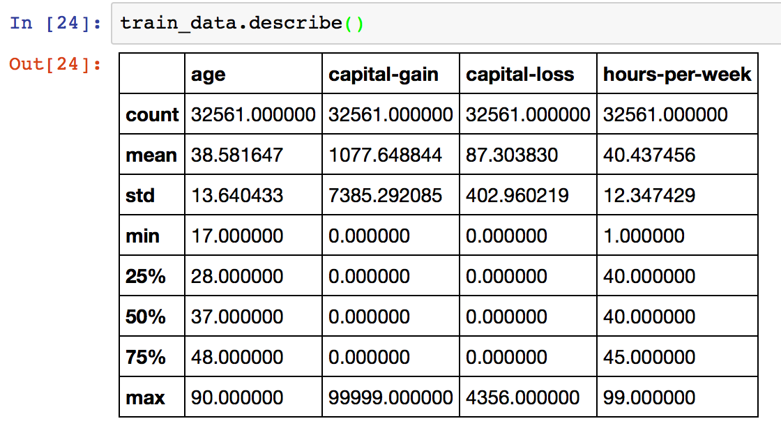
Numeric feature summary

Slide 57
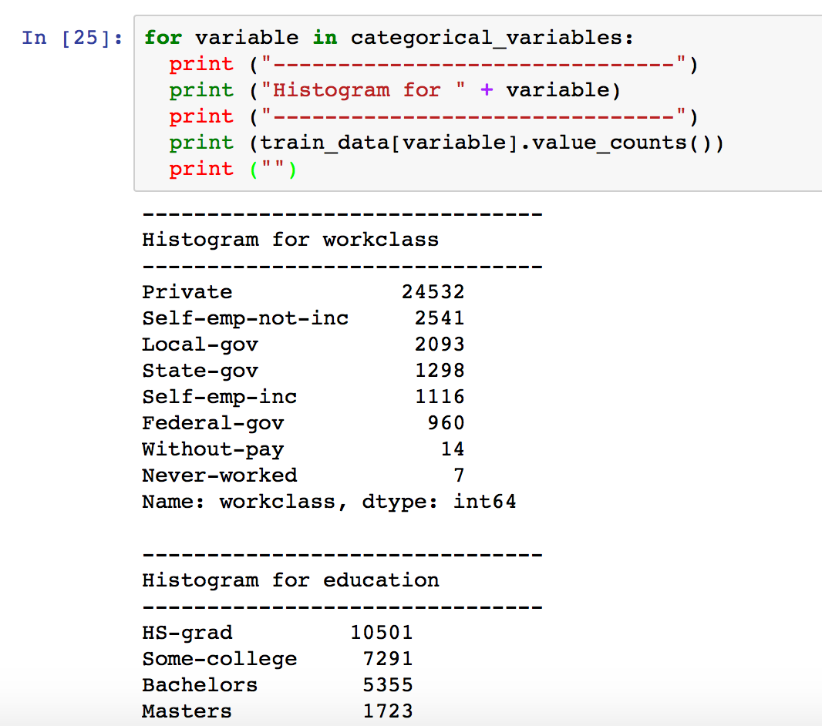
Categorical feature summary(Histogram)

Slide 58
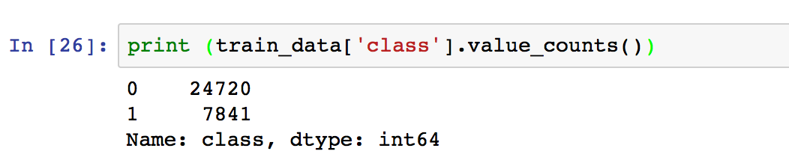
Class distribution
Class balance is important
Imbalanced datasets lead to bad model performance.
Down-sampling majority classes
Up-weighting minority classes

Slide 59
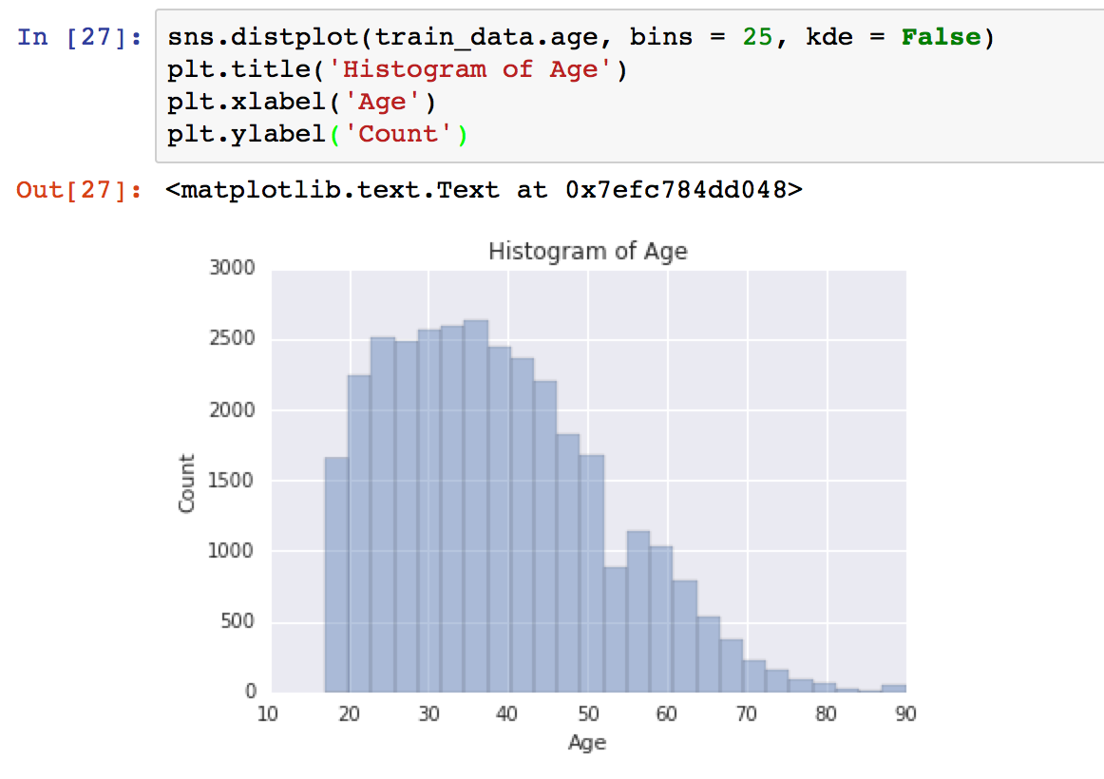
Histograms

Slide 60
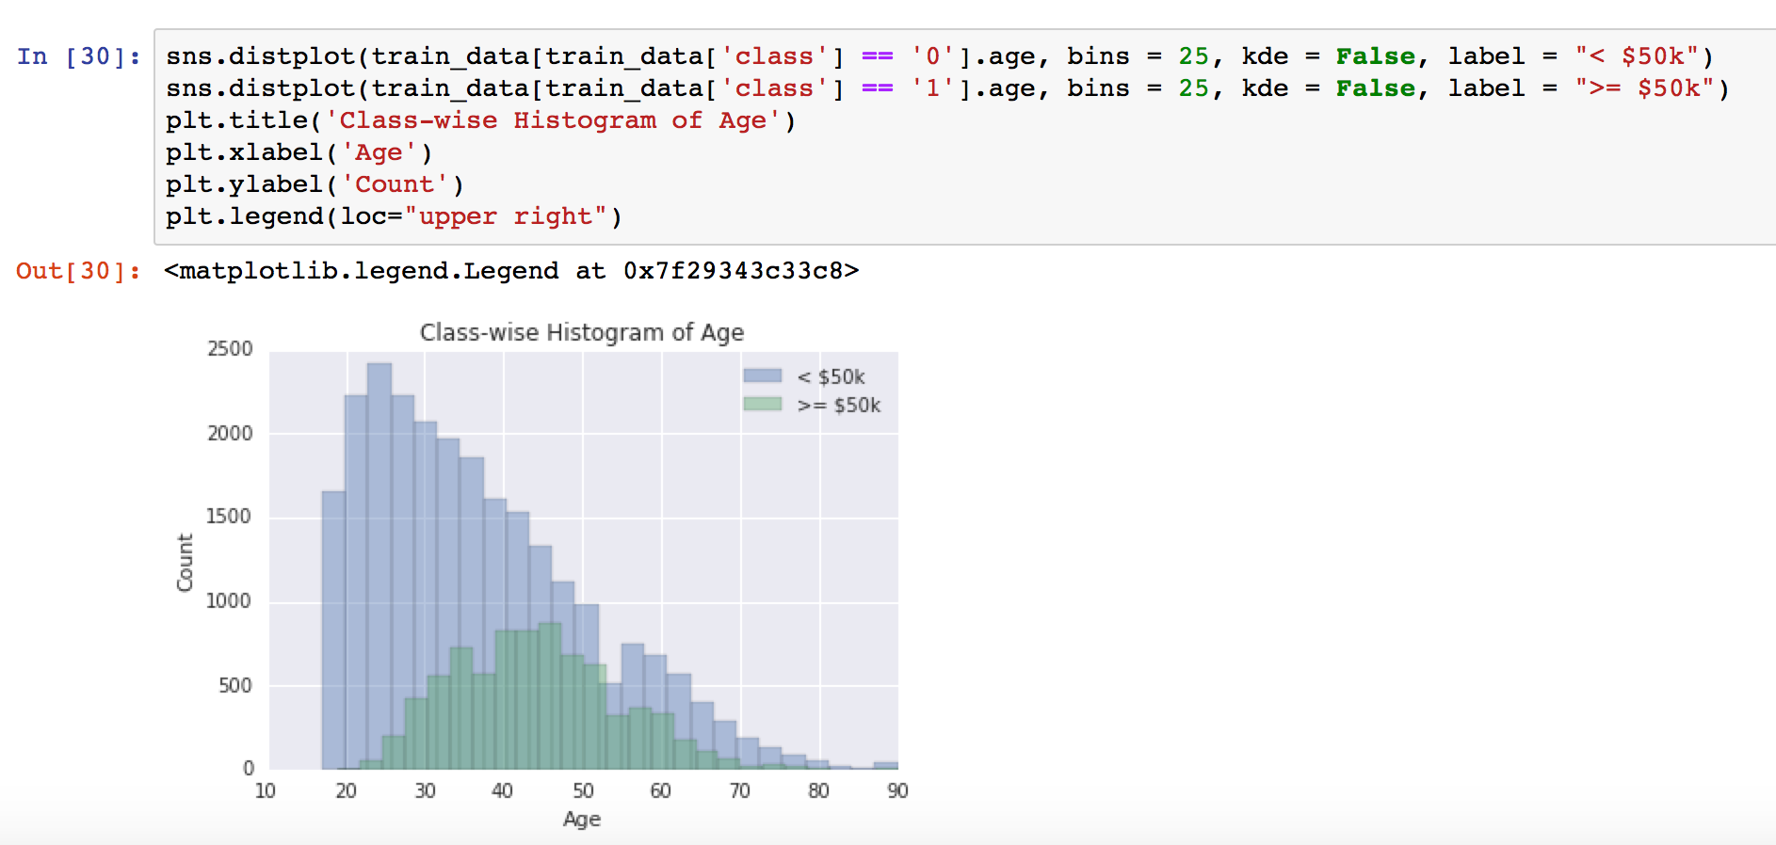
Feature-target correlation

Slide 61
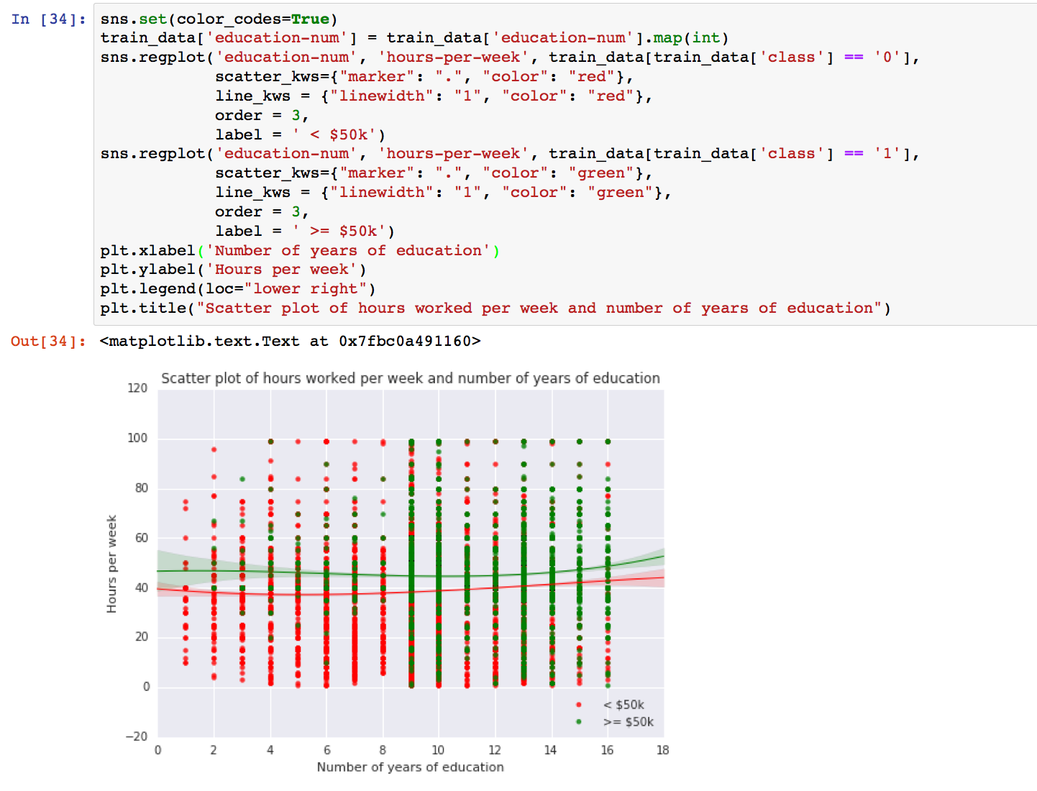
Feature-Feature correlation(Scatter plots)

Slide 62
Hands-on Session
Background

Slide 63
Model Building Process
Business Problem
ML Problem Framing
ML Problem + Metrics
Data Collection & Integration
Dataset
Data Preparation & Cleaning
High Quality Dataset
Data Visualization & Analysis
Data Summary reports
Data Augment
Feature Engineering
Feature Augment
Feature Vectors + Target
Model Training + Parameter Tuning
Predictive Model
Model Evaluation
Performance Metrics
Meet Business Goals?
No
Yes
Model Deployment
Predictions

Slide 64
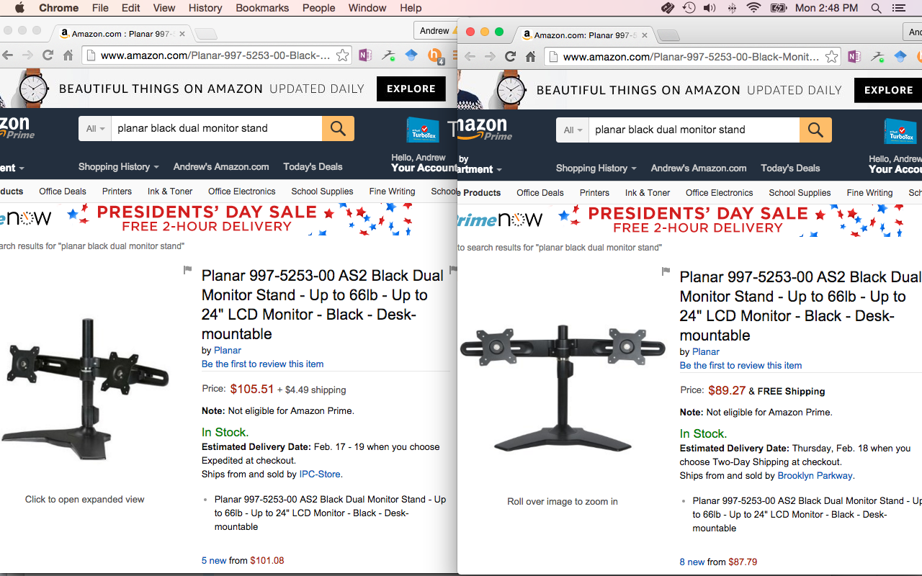
Deduplication Example

Slide 65
Features
What is a feature (in the deduplication context)?
Feature = a hint of a match or no-match decision.
A deduplication feature has the signature
def feature(record1: Record, record2: Record) : Double
Example:
def shipping_weight_match(x: Record,y: Record): Double =
if (x.shipping_weight == y.shipping_weight)
1.0
else
0.0
The machine learning model doesn’t see the data, only the features!

Slide 66
Feature Engineering
What am I using to make my decision?
How can I systematically encode this?
A feature usually measures the similarity of an attribute of the record pair
Can have multiple similarity metrics for a single attribute

Slide 67
Features for text fields
Example attributes of type text
item_name, product_description, bullet_point, brand
Some features
edit_distance(x,y)
jaccard_similarity(x,y)

Slide 68
Feature Engineering
Construct new features with predictive power from raw data -> boost model performance
Many types of feature transformations
Non-linear feature transformations for linear models
Domain-specific transformations for text etc.
Feature selection (drop noisy features)
Dimensionality reduction

Slide 69
Numeric Value Binning
Introduce non-linearity into linear models
Intuition: Salary isn’t linear with age
Binning strategies: equal ranges, equal number of examples, maximize purity measure (e.g. entropy) of each bin
Age | Binned Age | Education | Years of education | Marital status | Occupation | Sex | Label
39 | Bin2 | Bachelors | 16 | Single | Adm-clerical | Male | -1
31 | Bin2 | Masters | 18 | Married | Engineer | Female | +1
44 | Bin3 | Bachelors | 16 | Married | Accounting | Male | -1
62 | Bin4 | Bachelors | 14 | Married | Engineer | Female | -1
Age | Education | Years of education | Marital status | Occupation | Sex | Label
39 | Bachelors | 16 | Single | Adm-clerical | Male | -1
31 | Masters | 18 | Married | Engineer | Female | +1
44 | Bachelors | 16 | Married | Accounting | Male | -1
62 | Bachelors | 14 | Married | Engineer | Female | -1
20
40
60
Binned Age:
Bin1
Bin2
Bin3
Bin4

Slide 70
Quadratic Features
Derive new non-linear features by combining feature pairs
Example: People with a Masters degree in Business make much more than people with Masters or Business degrees
Age | Education | Years of education | Marital status | Occupation | Sex | Education + Occupation | Label
39 | Bachelors | 16 | Single | Business | Male | Bachelors_Business | -1
31 | Masters | 18 | Married | Business | Female | Masters_Business | +1
44 | Bachelors | 16 | Married | Accounting | Male | Bachelors_Accounting | -1
62 | Masters | 14 | Married | Engineer | Female | Masters_Engineer | -1
Age | Education | Years of education | Marital status | Occupation | Sex | Label
39 | Bachelors | 16 | Single | Business | Male | -1
31 | Masters | 18 | Married | Business | Female | +1
44 | Bachelors | 16 | Married | Accounting | Male | -1
62 | Masters | 14 | Married | Engineer | Female | -1
Quadratic feature over Education and Occupation

Slide 71
Other Non-linear Feature Transformations
For numeric features
Log, polynomial power of target variable, feature values -> ensures a more “linear dependence” with output variable
Product/ratio of feature values
Tree path features: use leaves of decision tree as features
Capture complex relationships between feature values and target
Age < 40
Sex = Male
Education = Bachelors
Features

Slide 72
Domain-Specific Transformations
Text Features:
Frequent N-grams: Capture multi-word concepts
Parts of speech/Ontology tagging: Focus on words with specific roles
Stop-words removal/Stemming: Helps focus on semantics
Lowercasing, punctuation removal: Helps standardize syntax
Cutting off very high/low percentiles: Reduces feature space without substantial loss in predictive power
TF-IDF normalization: Corpus wide normalization of word frequency
Web-page features:
Multiple fields of text: URL, in/out anchor text, title, frames, body, presence of certain HTML elements (tables/images)
Relative style (italics/bold, font-size) & positioning

Slide 73
Feature Selection
Often, “Less is More“
Better generalization behavior (useful to prevent “overfitting”)
More robust parameter estimates with smaller number of non-redundant features
Strategies for selecting features with predictive power
Features that are strongly correlated with target variable
Information gain, mutual information, Chi-square score, Pearson’s correlation coefficient
Features with high correlation with residual of target given other variables
Forward/backward selection, ANOVA analysis
Features with high importance scores (e.g. weights) during model training

Slide 74
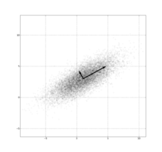
Dimensionality Reduction
Random projections: Consider projections along random directions (new features obtained by combining a random subset of features)
Principal Component Analysis (PCA): Consider projections in directions with maximum variance

Slide 75
Model Building Process
Business Problem
ML Problem Framing
ML Problem + Metrics
Data Collection & Integration
Dataset
Data Preparation & Cleaning
High Quality Dataset
Data Visualization & Analysis
Data Summary reports
Data Augment
Feature Engineering
Feature Augment
Feature Vectors + Target
Model Training + Parameter Tuning
Predictive Model
Model Evaluation
Performance Metrics
Meet Business Goals?
No
Yes
Model Deployment
Predictions

Slide 76
Parameter Tuning
Model training algorithms have multiple parameters
Loss function
Squared: regression, classification
Hinge: classification only, more robust to outliers
Logistic: classification only, better for skewed class distributions
Number of passes
More passes -> better fit on training data, but diminishing returns
Regularization
Prevent overfitting by constraining weights to be small
Learning parameters (e.g. decay rate)
Decaying too aggressively -> algorithm never reaches optimum
Decaying too slowly -> algorithm bounces around, never converges to optimum

Slide 77
Parameter Tuning Strategies
Optimize one parameter at a time (keeping others fixed at defaults)
May not work too well if strong correlation between parameters
Randomly explore joint parameter configuration space – stop when model performance improvement drops below threshold
Use k-fold cross-validation to evaluate model performance for a given parameter setting
Randomly split training data into k parts
Train models on k training sets, each containing k-1 parts
Test each model on remaining part (not used for training)
Average k model performance scores

Slide 78
Hands-on Session
Practical

Slide 79
Model Building Process
Business Problem
ML Problem Framing
ML Problem + Metrics
Data Collection & Integration
Dataset
Data Preparation & Cleaning
High Quality Dataset
Data Visualization & Analysis
Data Summary reports
Data Augment
Feature Engineering
Feature Augment
Feature Vectors + Target
Model Training + Parameter Tuning
Predictive Model
Model Evaluation
Performance Metrics
Meet Business Goals?
No
Yes
Model Deployment
Predictions

Slide 80
Classification – Making Predictions
Customer Transactions – Blues are Good (-1), Reds are Fraud (+1)
Score using transaction attributes to create a rank order from low to high risk
Operational Decision Point: Thresholding on the score (User has to choose! )

Slide 81
Classification – Evaluation Metrics
For each threshold, Confusion matrix for binary classification of +1 vs. -1
Precision = TP/(TP+FP): How correct are you on the ones you predicted +1?
Recall = TP/(TP+FN): What fraction of actual +1’s did you correctly predict ?
True Positive Rate (TPR) = Recall
False Positive Rate (FPR) = FP/(FP+TN): What fraction of -1’s did you wrongly predict?
 | Actual +1 | Actual -1
Predicted +1 | TP | FP
Predicted -1 | FN | TN

Slide 82
ROC Curve & AUC
AUC: Area under ROC curve
Plots TPR vs FPR for different thresholds
Odds of scoring +1 > -1
Perfect: AUC =1
Random: AUC =0.5
90%
True Positive Rate
Operational point: TPR – FPR is maximum
False Positive Rate

Slide 83
Precision-Recall Curve
1
High Precision
High Recall
0.75
Precision
0.5
0.25
0
0.25
0.5
0.75
1
Recall

Slide 84
Classification: Picking an Operational Point
Binary Classification: Score threshold corresponds to operational point
Application-specific bounds on Precision and/or Recall
Maximize precision (or recall) with a lower bound on recall (or precision)
Application-specific misclassification cost matrix
Optimize the overall misclassification cost (TP*C_{TP} +FP*C_{FP} + TN*C_{TN} + FN*C_{FN} )
Reduces to typical misclassification error when C_{TP} =C_{TN}=0 and C_{FP} =C_{FN} =1
 | Actual +1 | Actual -1
Predicted +1 | C_{TP} | C_{FP}
Predicted -1 | C_{FN} | C_{TN}

Slide 85
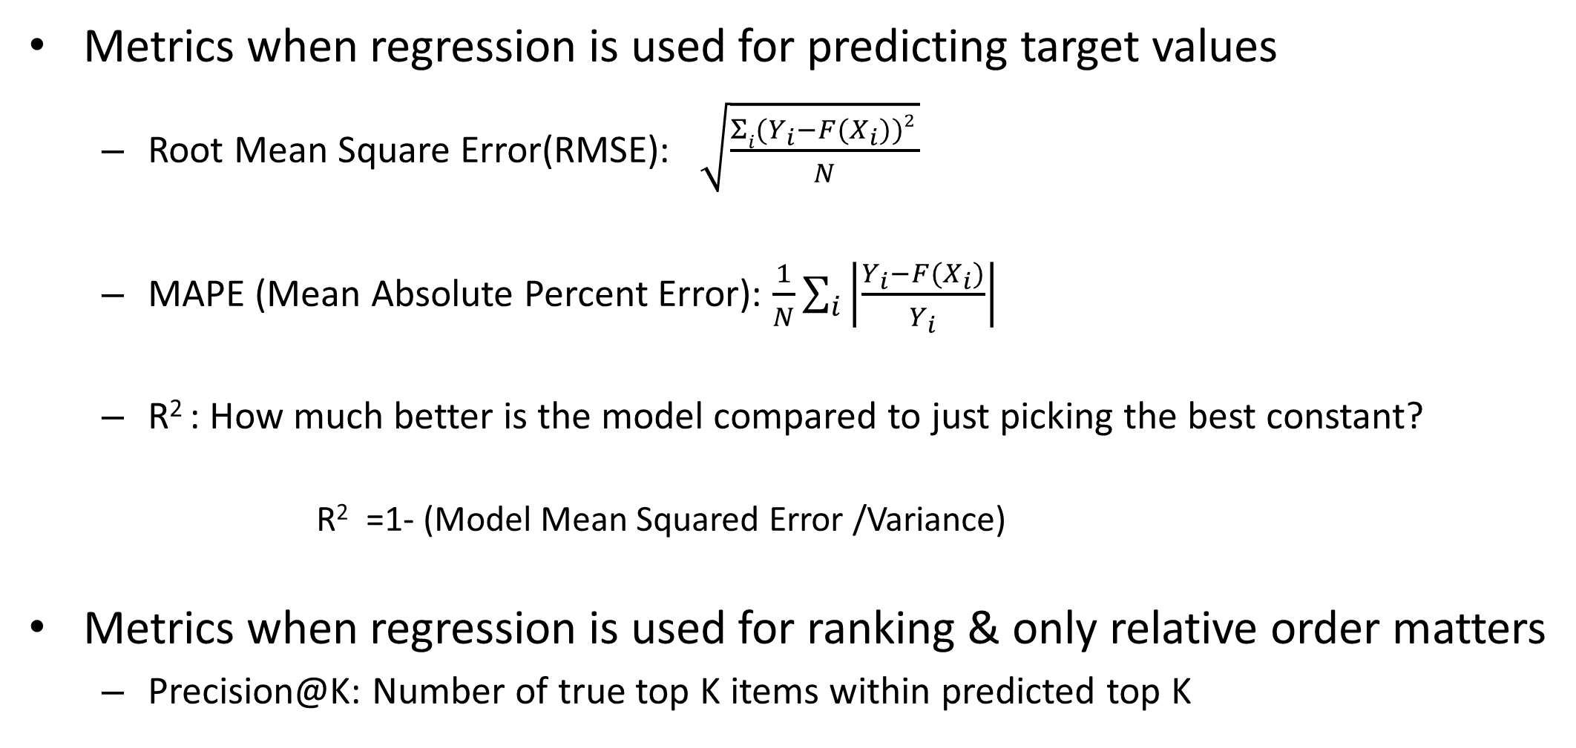
Regression – Evaluation Metrics
Metrics when regression is used for predicting target values
Root Mean Square Error(RMSE):
MAPE (Mean Absolute Percent Error):
R² : How much better is the model compared to just picking the best constant?
R² =1- (Model Mean Squared Error /Variance)
Metrics when regression is used for ranking & only relative order matters
Precision@K: Number of true top K items within predicted top K

Slide 86
Model Building Process
Business Problem
ML Problem Framing
ML Problem + Metrics
Data Collection & Integration
Dataset
Data Preparation & Cleaning
High Quality Dataset
Data Visualization & Analysis
Data Summary reports
Data Augment
Feature Engineering
Feature Augment
Feature Vectors + Target
Model Training + Parameter Tuning
Predictive Model
Model Evaluation
Performance Metrics
Meet Business Goals?
No
Yes
Model Deployment
Predictions

Slide 87
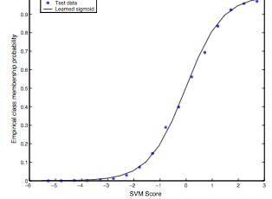
Classifier Scores to Probabilities
Score calibration requires a (small) hold out set of labeled instances
Binning method (Good for Naïve Bayes)
Rank hold out instances based on scores F(X) and partition them into equal sized bins
Estimate score to probability mapping using the true label distribution in each score bin
/* B(X): score bin containing F(X) */
Modeling via logistic function (Good for linear models e.g., SVMs)
Find parameters (a, b) that maximize hold out data log likelihood

Slide 88
Handling Imbalanced Datasets
Many applications have skewed class distribution (e.g. clicks vs non-clicks)
majority class may dominate, class boundary cannot be learned effectively
Strategies
Downsampling: Downsample examples from majority class
Oversampling: Assign higher importance weights to examples from minority class
Multi-stage models: Set thresholds to filter out majority class in each stage
Actual boundary
Learned boundary

Slide 89
Handling Asymmetric Misclassification Costs
Application-specific requirements dictate different costs for different errors (FPs vs FNs)
E.g. Find matching products
Requires high precision, high cost for false positives
Assign high importance weights to negative (non-matching) examples
E.g. Detect adult content
Requires high recall, high cost for false negatives
Assign high importance weights to positive (adult) examples

Slide 90
Summary: Modeling Tips
The more training examples, the better
Large training sets lead to better generalization to unseen examples
The more features, the better
Invest time in feature engineering to construct features with signal
Evaluate model performance on separate test set
Tune model parameters on separate validation set (and not test set)
Pay attention to training data quality
Garbage in Garbage out, Remove outliers, target leakers
Select evaluation metrics that reflect business objectives
AUC may not always be appropriate, Log-likelihood, Precision@K
Retrain models periodically
Ensure training data distribution is in sync with test data distribution

Slide 91
Thank you!

